Slide 1
Natural Language Processing
Prof Somesh Nandi

Slide 2
Introduction
Language and Culture: Language embodies a community’s culture, traditions, and history, shaping its identity.
Human-Computer Interaction: Digital assistants like Alexa or Siri let users interact in natural language, not code.
Bridging the Gap: Computers process binary data, but Natural Language Processing (NLP) enables machines to understand human language.
Real-World Applications: NLP powers everyday tools like weather updates, schedule management, and personalized suggestions.
Core of Intelligent Systems: Any application involving human language relies on NLP techniques to interpret and respond appropriately.

Slide 3
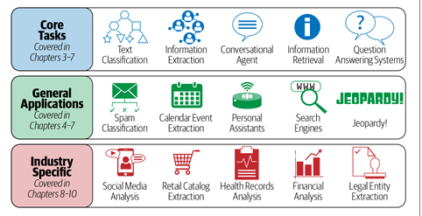
Introduction-NLP Tasks

Slide 4
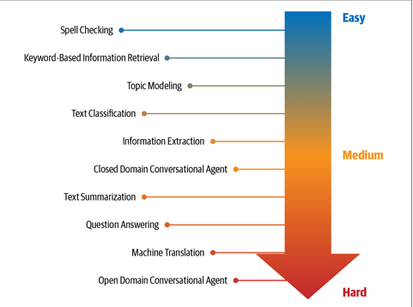
NLP -Tasks
Difficulty Level of NLP Tasks

Slide 5
What Is Language?
Language is a structured system of communication that involves complex combinations of its constituent components, such as characters, words, sentences, etc.
Linguistics is the systematic study of language. In order to study NLP, it is important to understand some concepts from linguistics about how language is structured.
Human language as composed of four major building blocks: pho nemes, morphemes and lexemes, syntax, and context.

Slide 6
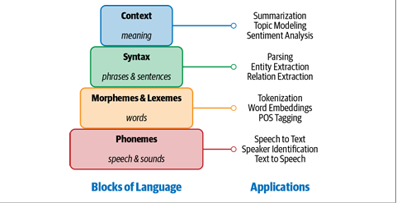
What Is Language?

Slide 7
Phonemes
Definition: Phonemes are the smallest units of sound in a language.
• No Independent Meaning: They may not have meaning on their own but create meaning when combined with other phonemes.
• Example: Standard English has 44 phonemes, consisting of single letters or letter combinations.
• Applications: Phonemes play a crucial role in speech-related applications such as:
Speech Recognition: Converting spoken words into text.
Speech-to-Text Transcription: Transcribing audio into written form.
Text-to-Speech Conversion: Generating spoken language from text.
Example : Phoneme is the sound /k/ in words like "cat", "kite", and "school"

Slide 8
Morphemes
The smallest unit of language that has meaning.
Formed by a combination of phonemes.
Not all morphemes are words (e.g., prefixes and suffixes are morphemes).
Example: In "multimedia", "multi-" is a morpheme that changes the meaning of "media."
Example: In "unbreakable", the morphemes are "un-", "break", and "-able".

Slide 9
Lexemes
A group of related words that share a common meaning.
Includes different variations of a word.
Example: "run," "running," and "ran" belong to the same lexeme.
Helps in NLP tasks like tokenization, stemming, and part-of-speech tagging.

Slide 10
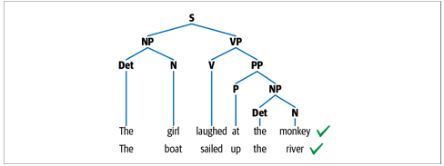
Syntax
This is a syntax tree (also known as a parse tree) that represents the structure of a sentence in terms of phrase structure rules from syntax in linguistics. It visually breaks down the sentence into its grammatical components.

Slide 11
Context
Context helps us understand the real meaning of words and sentences by considering additional information beyond just the literal meaning. Here’s how:
Context Combines Different Elements
It includes previous references, general world knowledge, and common sense.
Example: "I saw a bat." – This could mean a flying animal or a sports bat, depending on the situation.
Semantics: Direct Meaning of Words
It refers to the literal meaning of words and sentences.
Example: "The sun is hot." – The meaning is straightforward and doesn't change.
Pragmatics: Adding External Context
It includes real-world knowledge and conversational cues to infer implied meaning.
Example: "Can you pass the salt?" – Literally, it’s a question, but in conversation, it’s a request.

Slide 12
Context
Words Can Have Multiple Meanings
Some words or phrases change meaning based on context.
Example: "He is running." – It could mean jogging or running for an election.
Context is Crucial for NLP Tasks
Many Natural Language Processing (NLP) tasks rely on context, such as:
Sarcasm detection (e.g., "Oh great, another traffic jam!" – sarcasm)
Summarization (extracting key points while preserving meaning)
Topic modeling (understanding what a text is about)
Why Context Matters
Without context, sentences can be misunderstood.
Example: "Bank on the left." – It could mean a riverbank or a financial bank, depending on the conversation.

Slide 13
Why Is NLP Challenging?
The ambiguity and creativity of human language are just two of the characteristics that make NLP a demanding area.
Ambiguity: The sentence "I saw the man with the telescope." can have multiple meanings—did I use the telescope to see the man, or did the man have the telescope? This syntactic ambiguity makes NLP challenging.
Creativity: Consider the phrase "The moonlight danced on the waves." While literally impossible, this poetic expression conveys imagery and emotion, requiring NLP models to understand figurative language.

Slide 14
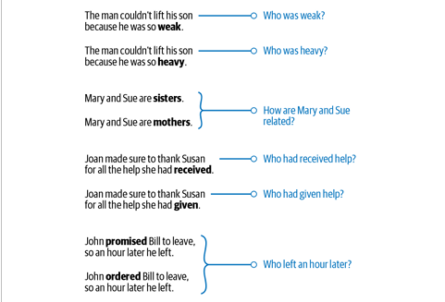

Slide 15
Why Is NLP Challenging?
Common knowledge refers to information that is widely known and accepted by many people without needing specific evidence or citation. It includes facts that are generally understood by the public or a particular group.
For example, consider two sentences: “man bit dog” and “dog bit man.” We all know that the first sentence is unlikely to happen, while the sec ond one is very possible. Why do we say so? Because we all “know” that it is very unlikely that a human will bite a dog. Further, dogs are known to bite humans
Diversity across languages For most languages in the world, there is no direct mapping between the vocabularies of any two languages.
This makes porting an NLP solution from one language to another hard. A solution that works for one language might not work at all for another language

Slide 16
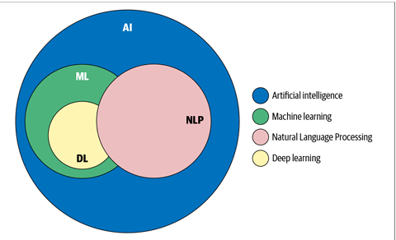
Machine Learning, Deep Learning, and NLP: An Overview

Slide 17
Approaches to NLP
The different approaches used to solve NLP problems commonly fall into three cate gories: heuristics, machine learning, and deep learning.
Rule Based Approach (Heuristics)
In the early days of Natural Language Processing (NLP), computers didn’t "understand" language like humans do. Instead, developers created rules to help computers process language.
These rules were handwritten by experts who knew a lot about language and grammar.

Slide 18
Approaches to NLP
Rule Based Approach (Heuristics)
How Did It Work?
To build these systems, developers used resources like dictionaries and thesauruses (word lists with meanings and synonyms).
For example, in sentiment analysis (deciding if a text is positive or negative), the system would count positive and negative words to determine the overall mood of a sentence.
Example: "I love this product! It's amazing!" → More positive words = Positive sentiment
Example: "This movie is terrible and boring." → More negative words = Negative sentiment
WordNet: A Smart Word Database
Over time, experts built better knowledge bases to improve NLP. One famous example is WordNet – a collection of words and their relationships.
WordNet helps computers understand connections between words in three ways:
Synonyms – Words that mean the same thing.
Example: Happy and Joyful are synonyms.
Hyponyms – A specific type of something.
Example: Football and Basketball are types of Sports.
Meronyms – A part of something.
Example: Hand and Leg are parts of the Body.

Slide 19
Approaches to NLP
Regular Expressions (Regex)
What it does: Regex is a pattern-matching technique used to find specific words, numbers, or patterns in text.
Example:
A regex like ^([a-zA-Z0-9_\-\.]+)@([a-zA-Z0-9_\-\.]+)\.([a-zA-Z]{2,5})$ can be used to find email addresses in a document.
If we apply this to a text containing hello@example.com, it will recognize it as an email.
How it helps in NLP:
Regex can help identify product codes in customer complaints.
Example: If a complaint says, "My phone model A123 is not charging", a regex can detect A123 and link it to a specific product.

Slide 20
Approaches to NLP
Context-Free Grammar (CFG)
What it does: CFG is a system for defining language rules. Unlike regex, CFG helps analyze the structure of sentences (not just words).
Example:
Consider the sentence: “The girl laughed at the monkey.”
A CFG rule could define that a sentence (S) is made of a noun phrase (NP) and a verb phrase (VP), where:
NP → "The girl"
VP → "laughed at the monkey"
Why use CFG?
It helps computers understand grammar and parse (analyze) sentences in a structured way.

Slide 21
Machine Learning Approach
Machine Learning for Text
ML is used to process text just like it is used for images, speech, and structured data.
1. Supervised Learning in NLP
What it does: Learns from labeled data (where we already know the correct answer).
Example:
Classification Task → Categorizing news articles into topics like sports, politics, or technology.
Regression Task → Predicting a stock’s price by analyzing social media discussions about the company.
2. Unsupervised Learning in NLP
What it does: Finds patterns in text without labeled data.
Example:
Clustering → Grouping similar articles together (e.g., all articles about AI in one cluster, all about sports in another).

Slide 22
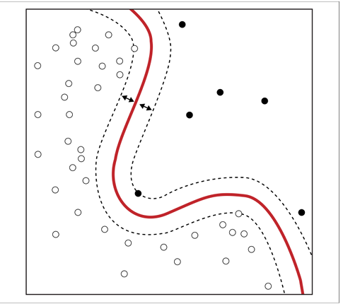
Machine Learning Approach
Naïve Bayes
Based on Bayes’ theorem
Assumes feature independence (e.g., word counts in text classification are treated as independent)
Pros: Simple, fast, and works well as a baseline model
Cons: The independence assumption is often unrealistic
Support Vector Machine (SVM)
Learns an optimal decision boundary to separate classes
Can handle both linear and nonlinear separation
Pros: Robust to noise, works well with high-dimensional data
Cons: Computationally expensive, struggles with large datasets

Slide 23
Hidden Markov Model
A Hidden Markov Model (HMM) is a statistical tool that helps us understand processes that are not directly observable.
It assumes that there is an underlying hidden process (like the grammar or structure of a sentence) that generates the data we see (like the words in a sentence).
In simpler terms, imagine you're reading a sentence. You can't directly see the underlying structure (like whether a word is a noun, verb, adjective, etc.).
But you can guess it based on how the words appear in sequence.
HMMs are used to predict these hidden parts of language, like parts of speech (POS), in tasks like tagging whether a word is a noun or verb in a sentence.

Slide 24
Hidden Markov Model
How HMM works:
Hidden States: These are the things we can’t see directly, like parts of speech (noun, verb, etc.).
Observed Data: These are the words in the sentence, which we can see and analyze.
Markov Assumption: The model assumes that each part of speech depends on the previous one, just like how the current word in a sentence often depends on the word before it.
Imagine this sentence:
"The cat sleeps."
How it works:
The HMM has a list of hidden states (parts of speech: noun, verb, etc.) and transitions between them. For example, the model knows that after a noun, a verb is likely to follow.
The model will look at the word "cat" and think, “Okay, "cat" is probably a noun because it's preceded by "the" (a determiner)."
Then, it looks at "sleeps" and says, “Since "cat" was a noun, "sleeps" is likely a verb.”

Slide 25
Why Deep Learning Is Not Yet the Silver Bullet for NLP
1. Overfitting on Small Datasets
DL models have many parameters, making them complex but also prone to memorizing data instead of learning patterns.
They work best with large datasets, but when trained on small datasets, they fail to generalize well.
Simple models (like Naive Bayes or logistic regression) often perform better on small datasets.
2. Few-Shot Learning & Synthetic Data Generation
In computer vision, DL has made progress in learning from very few examples (few-shot learning).
Image generation using DL has also improved significantly, helping train models with limited data.
However, similar advancements for NLP are still lacking, making it harder to train NLP models with limited text data.

Slide 26
Why Deep Learning Is Not Yet the Silver Bullet for NLP
3. Domain Adaptation
A DL model trained on news articles might not work well on social media posts or legal documents.
Language varies across domains, and DL models struggle when applied to new topics without retraining.
Domain-specific models (or rule-based approaches) often perform better in specialized fields like law or medicine.
4. Interpretable Models
DL models work like a "black box," meaning it’s hard to understand why they make certain predictions.
Businesses and users prefer explanations, which traditional models (like Naive Bayes) can provide.
Unlike computer vision, where we can visualize why an image was classified a certain way, NLP lacks strong interpretability techniques.

Slide 27
Why Deep Learning Is Not Yet the Silver Bullet for NLP
5. Common Sense & World Knowledge
Humans use logic and common sense while understanding language (e.g., "If John is in the garden, he’s not in the bedroom").
DL models struggle with logical reasoning and connecting real-world knowledge to language tasks.
Some efforts exist to teach AI common sense, but they are not yet well-integrated into NLP models.
6. On-Device Deployment
Some applications (e.g., offline translators for tourists) need NLP models to run on small devices instead of cloud servers.
DL models are too large and power-hungry to fit into mobile devices with limited memory and battery.
There is ongoing research to optimize DL for edge devices, but we are still far from efficient solutions.

Slide 28
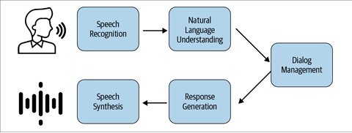
An NLP Walkthrough: Conversational Agents
Speech Recognition and Synthesis
Speech Recognition converts spoken words into text (e.g., "Hey Siri, play a song" → text format).
Speech Synthesis does the reverse—turning text into speech (e.g., the assistant replies, "Playing your favorite song").
These tasks use phonemes (basic speech sounds) to understand and generate language.
Example: When you say, "What’s the weather today?", the assistant converts your voice to text and processes the query.

Slide 29
An NLP Walkthrough: Conversational Agents
2. Natural Language Understanding (NLU)
This step analyzes the meaning of the user's request using different NLP techniques:
Sentiment Analysis: Understands emotions (e.g., "I love this song!" → Positive sentiment).
Named Entity Recognition (NER): Identifies important words (e.g., "Book a flight to Paris" → Paris is recognized as a location).
Coreference Resolution: Links words referring to the same thing (e.g., "Avengers: Endgame was great. The movie had amazing effects." → "The movie" refers to "Avengers: Endgame")

Slide 30
An NLP Walkthrough: Conversational Agents
3. Dialog Management
Once the system understands the request, it determines the intent and how to respond:
Intent Classification: Identifies the purpose (e.g., "Play Mozart songs" → Music request, "What is the weather?" → Information request).
The system may ask clarifying questions (e.g., "Which artist’s songs would you like to play?").
Action Selection: Decides what to do next—fetching data, playing music, or controlling a smart device.
Example: Saying "Turn on the lights" triggers the system to execute the command.

Slide 31
An NLP Walkthrough: Conversational Agents
Response Generation
The assistant formulates a reply based on the extracted information.
It can either fetch pre-existing answers (e.g., "The weather is 30°C and sunny") or generate new responses dynamically.
Uses pre-defined templates (e.g., "Now playing Symphony No. 25") or AI-based text generation.
Example: If you ask, "What is the capital of France?", it retrieves the answer "Paris is the capital of France."

Slide 32
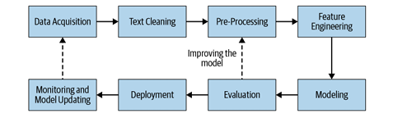
NLP Pipeline
The whole is more than the sum of its parts. It is more correct to say that the whole is something else than the sum of its parts, because summing up is a meaningless procedure, whereas the whole-part relationship is meaningful.

Slide 33
NLP Pipeline
Data Collection & Cleaning
Gather relevant text data for the NLP task (e.g., customer reviews, chatbot conversations).
Remove noise like special characters, stopwords, and duplicate entries.
Pre-processing
Normalize text (convert to lowercase, remove punctuation).
Perform stemming/lemmatization to reduce words to their root form (e.g., running → run).
Feature Engineering
Extract useful features like word embeddings, TF-IDF, or n-grams to represent text.
Convert text into a structured format for machine learning models.
Modeling & Evaluation
Train different NLP models (e.g., Naïve Bayes, LSTMs, BERT).
Evaluate them using metrics like accuracy, F1-score, BLEU score for comparison.
Deployment & Monitoring
Deploy the best-performing model for real-world use.
Continuously monitor and update the model to maintain accuracy.

Slide 34
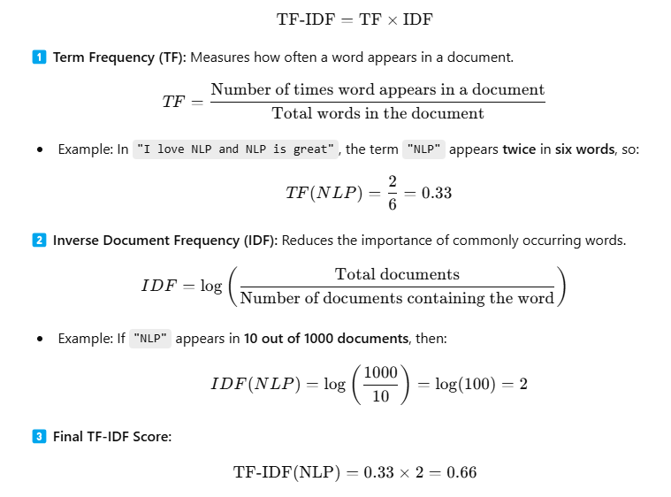
TF-IDF (Term Frequency - Inverse Document Frequency)
TF-IDF is a technique used in Natural Language Processing (NLP) to measure the importance of a word in a document relative to a collection of documents (corpus). It helps in filtering out common words (like "the", "is", "and") while keeping the important ones.

Slide 35
Data Acquisition
1️⃣ Use Public Datasets
Check if there’s already a free dataset available online.
Websites like Google Dataset Search or Kaggle have thousands of datasets.
If a dataset matches your needs, great! You can start training your model.
✅ Example: Using an open-source movie reviews dataset to build a sentiment analysis model.
2️⃣ Scrape Data from the Internet
If a suitable dataset isn’t available, find relevant information online.
Websites like forums, social media, and customer support pages have real-world data.
Use web scraping tools to extract data and label it manually.
✅ Example: Scraping Amazon reviews to analyze customer opinions on a product.

Slide 36
Data Acquisition
4️⃣ Product Intervention (Built-in Data Collection)
Companies integrate AI into their products to collect real-world data.
Tech giants (Google, Facebook, Netflix) gather massive amounts of user data this way.
The more people use a product, the better the AI model becomes.
✅ Example: YouTube recommends videos based on your watch history (AI learns from user behavior).
5️⃣ Data Augmentation (Creating More Data)
If data collection is slow, create synthetic data to speed up training.
Modify existing data by paraphrasing, translating, or generating text using AI.
This helps improve model accuracy without waiting months for real-world data.
✅ Example: Using AI to generate variations of product descriptions for training an NLP model.

Slide 37
Data Augmentation Techniques in NLP
Synonym Replacement
🔹 Pick a few words in a sentence (except stop words). 🔹 Replace them with synonyms (words with similar meanings). 🔹 Use WordNet to find synonyms.
✅ Example: 📌 Original: "The food was delicious and tasty." 📌 Augmented: "The food was yummy and tasty.“
Back Translation
🔹 Translate a sentence into another language (e.g., English → German). 🔹 Translate it back into English. 🔹 This creates a slightly different version of the sentence.
✅ Example: 📌 Original: "The weather is nice today." 📌 Translate to French: "Le temps est agréable aujourd'hui." 📌 Translate back to English: "The climate is pleasant today."

Slide 38
Data Augmentation Techniques in NLP
TF-IDF-Based Word Replacement
🔹 Some words in a sentence are more important than others. 🔹 TF-IDF helps us find key words that shouldn’t be lost. 🔹 Instead of random replacements, we keep important words unchanged.
✅ Example: 📌 Original: "The stock market crashed today." 📌 TF-IDF identifies "stock market" as important, so we don’t replace it.
Bigram Flipping
🔹 Break the sentence into bigrams (pairs of two words). 🔹 Swap a random bigram to change the sentence structure.
✅ Example: 📌 Original: "I am going to the supermarket." 📌 Augmented: "I am to going the supermarket."

Slide 39
Data Augmentation Techniques in NLP
Replacing Entities (Names, Places, etc.)
🔹 Replace names, locations, or organizations with similar ones.
✅ Example: 📌 Original: "I live in California." 📌 Augmented: "I live in London."
Adding Noise to Data
🔹 Real-world data has typos (especially on social media). 🔹 Simulate errors like misspellings or keyboard mistakes. 🔹 Helps the model learn to handle messy text.
✅ Example: 📌 Original: "I love programming!" 📌 Augmented: "I lvoe programming!" (typo)
Advanced Data Augmentation Techniques
✅ Snorkel → Automatically creates labeled datasets using rules. ✅ EDA & NLPAug → Popular Python libraries for text augmentation. ✅ Active Learning → AI selects the most useful data to label, saving effort.

Slide 40
Text Extraction and Clean up
What is it?
It's the process of pulling out only the useful text from files or web pages.
We remove things like HTML tags, metadata, ads, and scripts that we don’t need.
Why do we need it?
So that we can feed clean and readable text into machines or AI tools for further processing.
Helps in data analysis, search engines, chatbots, etc.
Where do we get this text from?
PDFs, Word files, websites (HTML), emails, or even live data streams.
Is it part of NLP (Natural Language Processing)?
Not really. It’s a preparation step before NLP.
No fancy language tricks here — just basic cleaning.

Slide 41
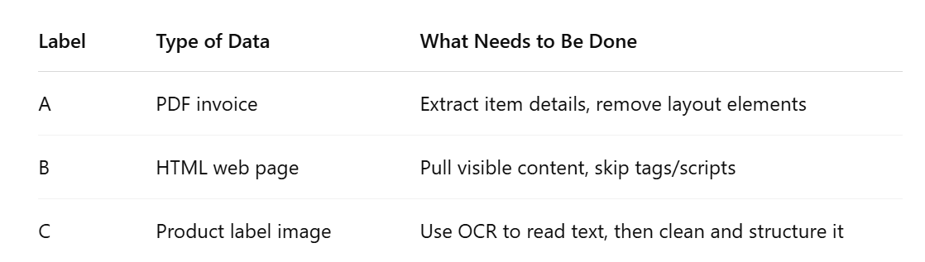

Slide 42
HTML Parsing and Cleanup
Imagine you’re reading something on a website like Stack Overflow (a popular site where programmers ask and answer questions).
Now, suppose you want to collect a question and its best answer from that website automatically — instead of copying and pasting them manually.
What is Text Extraction and Cleanup?
Taking just the useful text from a file (like a PDF or a web page).
Removing extra stuff like HTML tags (<div>, <script>), metadata, or code that tells the website how to look and behave.
Cleanup means:
Making sure the text is readable and clean, so we can use it later (like feeding it into a search engine or chatbot).

Slide 43
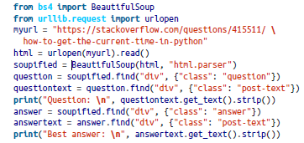
HTML Parsing and Cleanup
How Do We Do It from a Website?
<div class="question"> → the question part
<div class="answer"> → the answer part
Question:
What is the module/method used to get the current time?
Best answer:
Use:
>>> import datetime
>>> datetime.datetime.now()
datetime.datetime(2009, 1, 6, 15, 8, 24, 78915)

Slide 44
Unicode Normalization
The image shows a grid of special symbols and emojis (like 🚀, 🎵, 😺, 🧘), each with something like U+1F680 below it.
That code (like U+1F680) is called a Unicode code point. It’s how computers understand and store these symbols behind the scenes.

Slide 45
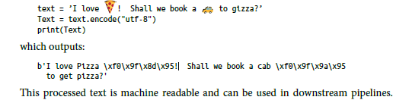
Unicode Normalization
Why do we need Unicode and encoding?
Computers don’t store text as characters like we see. They store numbers (binary). So every character, emoji, or symbol must be encoded into numbers first.
This is where Unicode and text encoding come in.
Unicode: A global standard to give every character (A-Z, 😍, €, etc.) a unique number.
UTF-8: A popular way to convert those numbers into bytes (the format that computers actually save and transmit).

Slide 46
Spelling Correction
When people type quickly or on mobile, they often make spelling mistakes — either:
Shorthand typing: Skipping letters to type faster
Example: Hllo world! instead of Hello world!
Fat-finger mistakes: Accidentally hitting the wrong key
Example: I pronise instead of I promise, or bresk instead of break
These mistakes confuse computers, especially when they try to understand meaning or context (like in chatbots, search engines, or social media analysis).

Slide 47
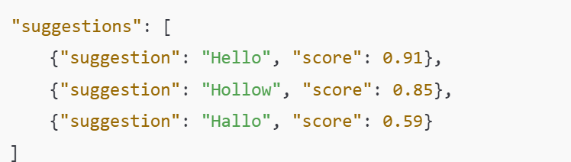
Spelling Correction
Use a Spell Checker API (like Microsoft’s)
Microsoft has a tool (a REST API) that you can use in Python. You give it a sentence, and it gives you suggestions for the misspelled words.
Build Your Own Spell Checker (Simple Idea)
If you don’t want to use an API, you can try writing your own checker using a dictionary of correct words (like from English language corpus).
🧠 How it works:
If a word is not in the dictionary, try:
Adding a letter
Deleting a letter
Replacing a letter

Slide 48
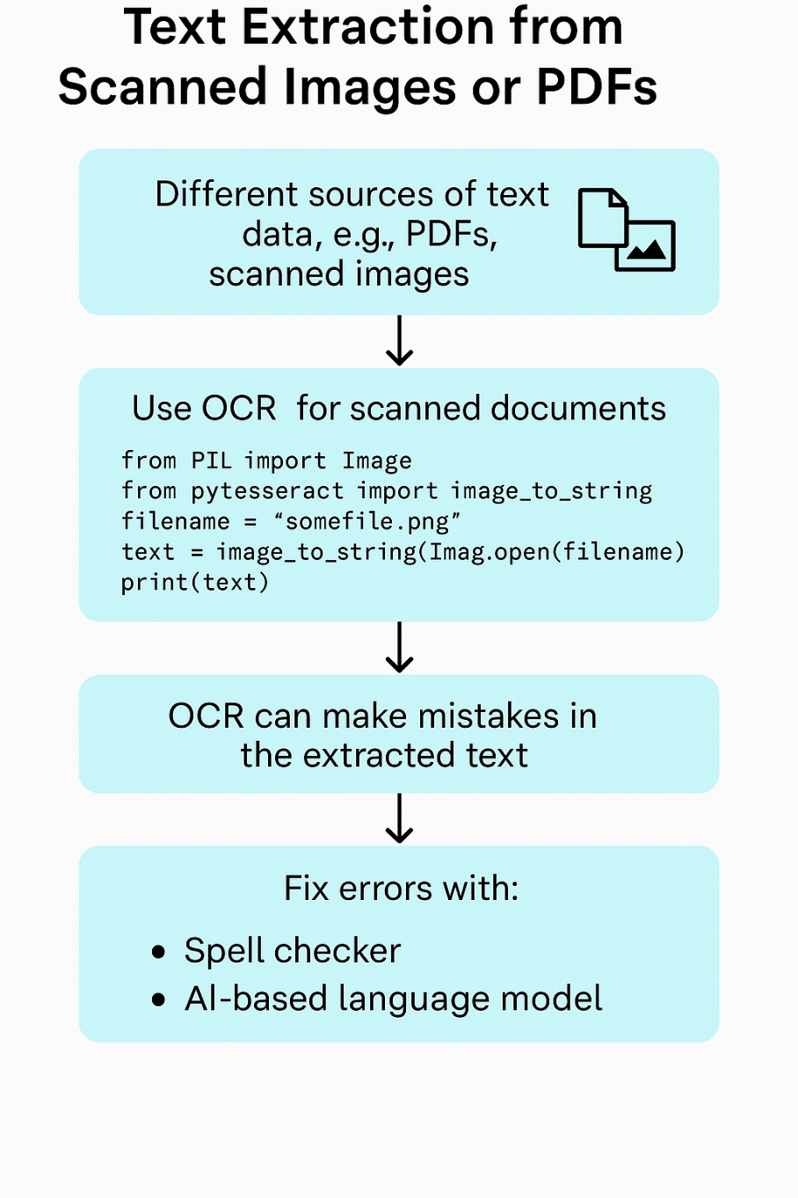
System-Specific Error Correction

Slide 49
Pre-Processing
Remove Irrelevant Data: Strips away HTML tags, links, and other noise from raw text.
Prepare Text for Analysis: Splits text into sentences and words for easier processing.
Standardize the Format: Converts all text to lowercase and removes unnecessary characters.
Reduce Complexity: Simplifies words to their root form using stemming or lemmatization.
Preliminaries
Sentence segmentation and word tokenization.
Frequent steps
Stop word removal, stemming and lemmatization, removing digits/punctuation,lowercasing, etc.
Other steps
Normalization, language detection, code mixing, transliteration, etc.
Advanced processing
POS tagging, parsing, coreference resolution, etc.

Slide 50
Preliminaries
Sentence Tokenization: Breaks large text into individual sentences using tools like sent_tokenize() from NLTK.
Why It's Needed: Simple punctuation rules can fail with abbreviations like "Dr." or ellipses "...", so libraries handle these better.
Word Tokenization: Splits each sentence into words using word_tokenize() for easier analysis.
Library Used: NLTK (Natural Language Toolkit) provides ready-made functions for both sentence and word splitting.

Slide 51
Preliminaries
from nltk.tokenize import sent_tokenize, word_tokenize
mytext = "NLP helps computers understand human language. It is used in chatbots and search engines. This process involves several steps."
my_sentences = sent_tokenize(mytext)
for sentence in my_sentences:
print(sentence)
print(word_tokenize(sentence))
O/P in next slide

Slide 52
Preliminaries
NLP helps computers understand human language.
['NLP', 'helps', 'computers', 'understand', 'human', 'language', '.']
It is used in chatbots and search engines.
['It', 'is', 'used', 'in', 'chatbots', 'and', 'search', 'engines', '.']
This process involves several steps.
['This', 'process', 'involves', 'several', 'steps', '.']

Slide 53
Preliminaries – Challenges
Most NLP libraries like NLTK provide tools to split text into sentences and words automatically.
These tools are helpful but not perfect — they can make mistakes in tricky situations.
For example, in “Mr. Jack O’Neil”, NLTK splits “O’Neil” into three parts: "O", "’", and "Neil".
In numbers with currency like “$10,000”, it separates "$" and "10,000", but keeps "€1000" as one token.
On platforms like Twitter, it may split hashtags (e.g., "#Happy") into "#" and "Happy", which is not ideal.
In such special cases, we might need to use or build a custom tokenizer that understands our data better.

Slide 54
Preliminaries – Challenges

Slide 55
Frequent Steps
Stop Words Removal:
Words like "a", "an", "the", "in", "of" are common in English.
These words don’t add useful meaning for many tasks, so we remove them.
These are called stop words.
Example:
Sentence: "The news is about a cricket match."
After removing stop words: "news cricket match“
Lowercasing:
Convert all words to lowercase, so that "News", "news", and "NEWS" are treated the same.
Remove Punctuation:
Symbols like . , ! ? are not useful for many tasks, so we remove them.
Remove Numbers:
Unless the task needs numbers, we also remove digits like 100, 2024, etc.

Slide 56
Stemming and lemmatization
Stemming means removing suffixes from words to get a base form.
Example:
“cars” becomes “car”
"running” becomes “run”
It uses fixed rules, like “remove -es, -ing, -ed”.
Doesn’t always give correct English words (called stems, not root words).
Example:
“revolution” becomes “revolut” (not a real word, but still okay for search engines).
🔍 Where is Stemming Used?
Search engines (to match similar words).
Text classification (to reduce vocabulary size).
It is fast and works well when perfect accuracy isn't required.

Slide 57
Stemming and lemmatization
from nltk.stem.porter import PorterStemmer
stemmer = PorterStemmer()
word1, word2 = "cars", "revolution"
print(stemmer.stem(word1), stemmer.stem(word2))
What is Lemmatization?
Similar to stemming, but more accurate and based on grammar and meaning.
It returns the correct base word (lemma).
Example:
“better” becomes “good”
“running” becomes “run”

Slide 58
Stemming and lemmatization
The following code snippet shows the usage of a lemmatizer based on WordNet from
NLTK:
from nltk.stem import WordNetLemmatizer
lemmatizer = WordnetLemmatizer()
print(lemmatizer.lemmatize("better", pos="a")) #a is for adjective
code snippet shows a lemmatizer using spaCy:
import spacy
sp = spacy.load('en_core_web_sm')
token = sp(u'better')
for word in token:
print(word.text, word.lemma_)

Slide 59
Summary of Pre Processing

Slide 60
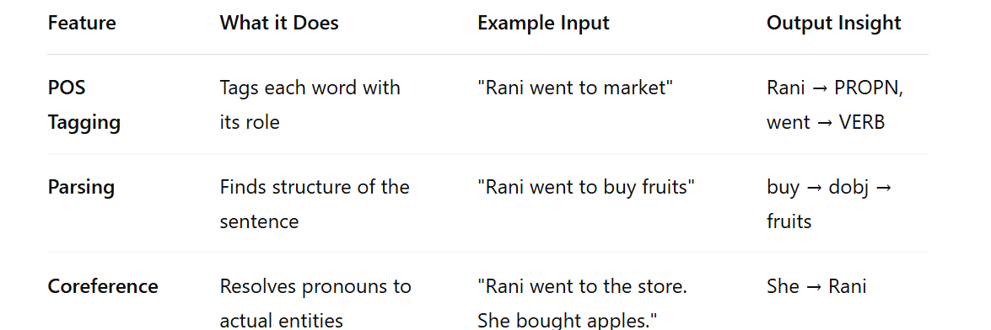
Advance Pre Processing

Slide 61
Summary of Advance Pre Processing

Slide 62
Feature Engineering
What is Feature Engineering?
Feature Engineering is the process of converting text into numbers that a machine learning model can understand.
Machines don't understand language — they understand vectors (numbers).
So we take text and extract important characteristics (called features) to represent it numerically.
This can be done in two ways
1.A classical NLP and traditional ML pipeline and
2. DL pipeline.

Slide 64
Classical NLP + Machine Learning Pipeline
Steps:
Preprocessing: Clean the text.
Tokenization: Split text into words.
POS Tagging: Label parts of speech like nouns, verbs.
Stopword Removal: Remove words like “the”, “is”, “and”.
Feature Engineering (aka Feature Extraction):
Turn text into numbers — e.g., count how many positive or negative words are in a review.
Modeling: Train a Machine Learning model (like SVM or Decision Trees) using the features.
Output: Get results like sentiment, classification, entity extraction, etc.
✅ Advantages:
Interpretability: You can see why the model made a decision.
❌ Disadvantages:
Needs manual feature design for each task.
Slower to experiment or improve performance.

Slide 65
Deep Learning-Based NLP Pipeline
📌 Steps:
Preprocessing: Basic cleaning.
Dense Embeddings: Text is converted to vectors using models like:
word2vec, GloVe, BERT etc.
Neural Network: This learns to detect features automatically.
Hidden layers extract complex patterns.
Output: Same tasks — classification, sentiment, etc.
✅ Advantages:
No need for manual feature engineering.
Learns better features from large data → higher accuracy.
❌ Disadvantages:
Hard to explain why it made a decision (less interpretable).

Slide 66
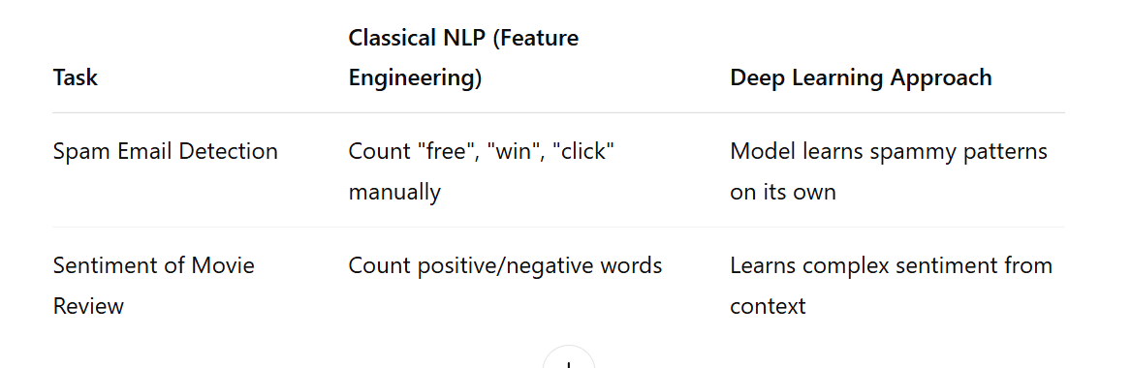
Feature Engineering – Comparison of Two Approaches

Slide 67
Modelling
Start Simple with Heuristics (Rules)
At the beginning, machine learning (ML) might not be useful right away if we don’t have enough data.
Instead, we can use human-made rules, called heuristics, to solve parts of the problem.
📌 Examples of Heuristics
Email Spam Detection:
Block emails from blacklisted domains.
Mark emails with certain spammy words (like “free”, “win”, “urgent”) as spam.
E-commerce Search/Recommendations:
Show popular products first (based on number of purchases).
Recommend items from the same category
Why Heuristics Help
They’re useful when:
You don’t have enough data to train an ML model.
You know the domain well and can write meaningful rules.
Even in ML models:
Use heuristics to handle edge cases where the model fails.

Slide 68
Modelling
From Heuristics to Machine Learning
After building a rule-based system, the next steps are:
Collect more data.
Analyze what works and what doesn’t.
Gradually add ML models to improve accuracy and reduce manual rules.
Building Your ML Model After Starting with Heuristics
🔹 Why Move Beyond Heuristics?
Heuristics (rules) are great in the beginning.
But adding too many rules can make the system:
Too complex
Hard to maintain
Difficult to fix errors
As We Get More Data
ML models become more powerful and perform better than just rules.
So we need to combine heuristics with ML smartly.

Slide 69
Building Model
Use Heuristics as Features for Your ML Model
Turn your rules into features the model can learn from.
Example (Email Spam Classification):
Feature 1: Number of blacklisted words in the email
Feature 2: Bounce rate of the sender’s domain
The ML model then learns from these features along with others.
Use Heuristics Before the ML Model (Pre-processing)
If a rule is very confident, let it make the decision.
Example:
If an email contains words that are 99% likely to be spam, just mark it as spam directly.
Don’t send it to the ML model – save time and resources.

Slide 70
Building THE Model
Ensemble and Stacking (Teamwork of Models)
🔸 Don’t just rely on one model—use a combination of models for better predictions.
Two main techniques:
📚 a. Model Stacking
One model’s output becomes input for another.
Like a relay race: Model 1 → Model 2 → Final result
Example: Heuristic model ➝ Naive Bayes ➝ LSTM ➝ Final classifier using logistic regression
📊 b. Model Ensembling
Use multiple models in parallel.
Each model gives its prediction, and we combine their outputs.
Like taking a vote among models and choosing the majority opinion or average.
✅ Helps in handling different parts of the problem better.

Slide 71
Better Feature Engineering (Feeding the Right Info)
Models are only as good as the data you give them.
Feature engineering = picking and designing useful input data.
Improve model performance by:
Selecting the most relevant features
Removing useless/noisy features
Creating new meaningful features from raw data
This is a continuous process as you understand your problem better.
Transfer Learning (Learning from Pretrained Models)
Use pretrained language models (like BERT) that already understand language well.
Then fine-tune them on your specific task.
🔄 It’s like a teacher (pretrained model) giving a student (your model) a head start.
Especially useful when you have less training data.
Example: Use BERT and fine-tune it for spam detection instead of training a model from scratch.

Slide 73
Evaluation
Intrinsic Evaluation (Evaluating the model internally)
📌 This checks how accurate the model is at the core NLP task
(like translation, summarization, classification),
without using it in a real-world application.
🔹 Examples:
If you built a sentiment analysis model, you might check:
Accuracy: How many times it correctly says the review is positive/negative.
Precision/Recall/F1 Score: More detailed metrics to understand performance.
If you built a translation model, you might use:
BLEU score: Compares your model’s translation with human translations.
💡 Think of it as:
"Is the model doing its job well?" — purely based on performance inside the lab.

Slide 74
Extrinsic Evaluation
Extrinsic Evaluation (Evaluating the model in real-world use)
📌 This checks how well the NLP model helps in a larger task or real-world application.
🔹 Examples:
Suppose your text summarization model is used inside a news app:
Intrinsic evaluation checks if the summary is grammatically correct and covers key points.
Extrinsic evaluation checks if:
Users find the summary helpful.
They spend more time on the app.
The summaries help journalists write faster.
Another example: A speech-to-text model used in a voice assistant.
Intrinsic: Word error rate.
Extrinsic: Does the assistant give the correct response after converting speech to text?
💡 Think of it as:
"Does the model help the overall system or user do better?"
— outside the lab, in a real app or task.

